Slide 1

Intel Image Classification
Deep Learning Final Project – CNN, Transfer Learning, Fine-Tuning

Slide 2
What Problem Do We Solve?
We aim to classify aerial/satellite images of different land-use types from the Intel
Image Classification dataset. The six classes are:
- Buildings
- Forest
- Glacier
- Mountain
- Sea
- Street
This helps in automating satellite image analysis and land-use planning.

Slide 3
What ML Methods Do We Use?
We experimented with four models:
1. Baseline CNN model
2. CNN with Early Stopping
3. Transfer Learning using MobileNetV2 (frozen layers)
4. Fine-tuned MobileNetV2 (unfrozen top layers)
Techniques used:
- Data Augmentation
- Dropout Regularization
- Learning Rate Adjustment

Slide 4
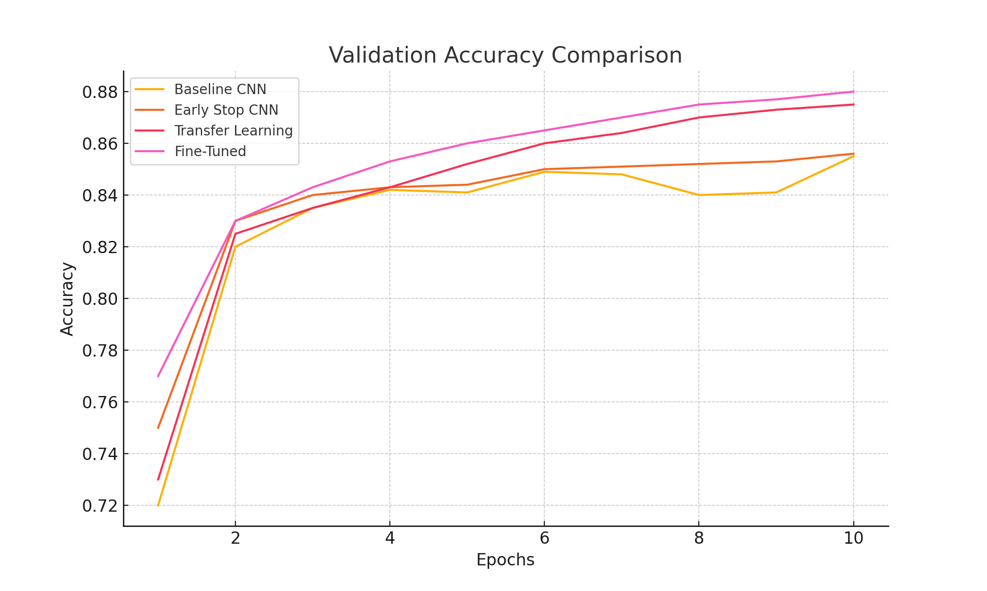
Model Comparison: Validation Accuracy

Slide 5
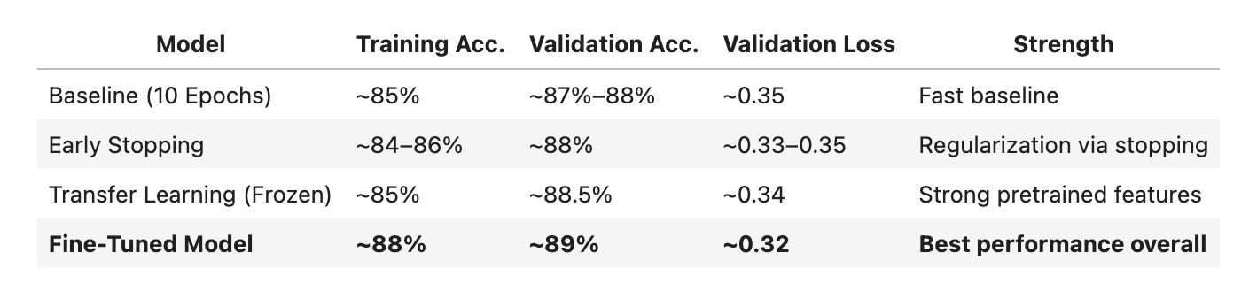
Overall Comparison Table

Slide 6
Conclusion & Takeaways
• Transfer Learning (MobileNetV2) significantly improved validation accuracy and generalization.
• Fine-tuning unlocked best performance (89% acc, 0.32 loss) by adapting pretrained features.
• Validation curves showed healthy generalization, minimal overfitting.
• Baseline (from scratch) plateaued early due to weak feature extraction.
• Early Stopping may limit full learning potential.
• Frozen Transfer Learning limited adaptability.

Slide 7
Suggestions
– Use stronger data augmentation.
– Apply gradual unfreezing (layer-wise fine-tuning).
– Explore better schedulers (e.g., cosine annealing).
– Try deeper/wider architectures (EfficientNet, ResNet).
– Apply k-fold CV or model ensembling.
• Balanced use of pretrained knowledge and dataset-specific tuning yields best results.

